Slide 1
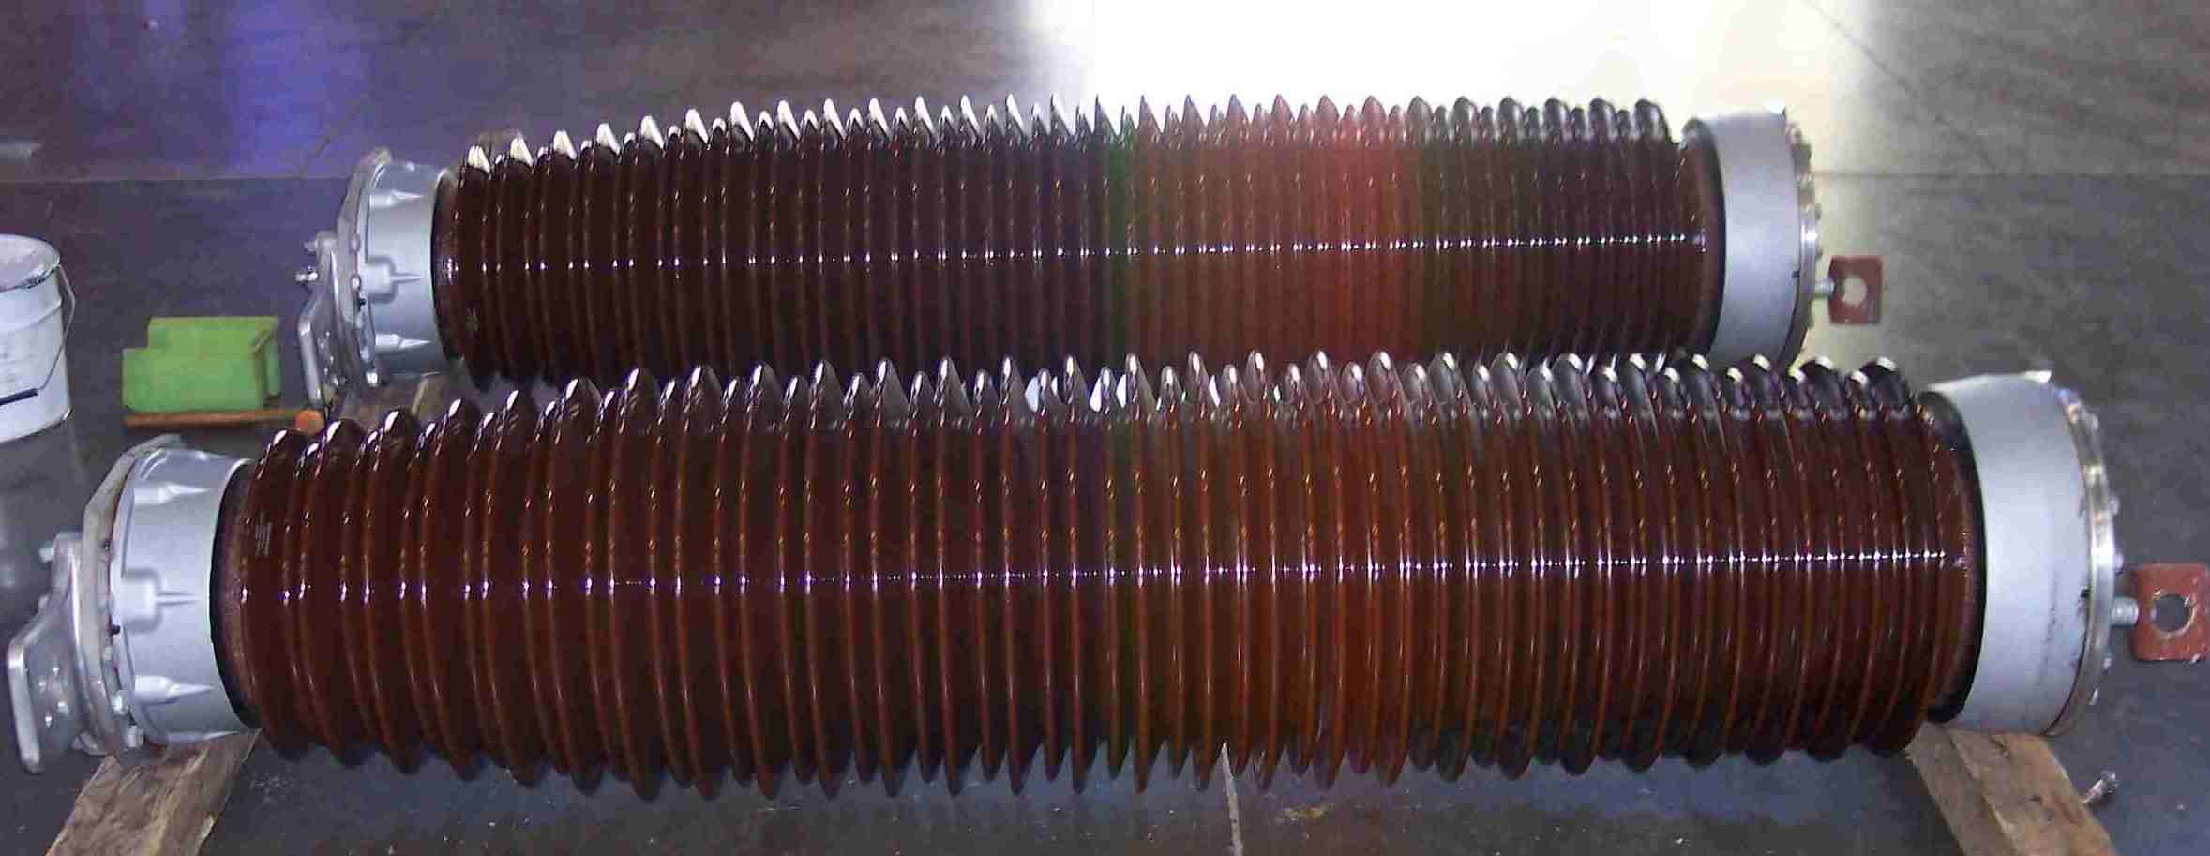
SIEMENS
HVCB SPARES
Chamber Insulator
245KV, 50KA CB
S4807082023

